Slide 1
United States Becomes a World Power

Slide 2
Vocabulary
Labor force – supply of workers.
Settlement house – community center for poor immigrants
Homestead Act – gave 160 acres of land to any adult willing to farm it and live on it for 5 years.
Communism – state owns all industries
Cold War – period of great tension, but not actual war between US and Russia
Civil rights movement – large group of people who worked together in the 1960’s to end segregation.

Slide 3
The United States From 1865 to 1914
Industrial Revolution made things much easier for the middle class.
1800’s a handful of people had millions in industry
We still had the city slums and many living there spoke little to no English.
Small children had to work to make ends meet.
These things lead to settlement houses being built.

Slide 4
The United States From 1865 to 1914
Homestead Act 1862 allowed poorer families to move to the Midwest to farm.
Wasn’t easy trees and water were in short supply
Insects
Prairie fires
Indiana like seasons (HOT and COLD)
Railroads helped speed up settlement

Slide 5
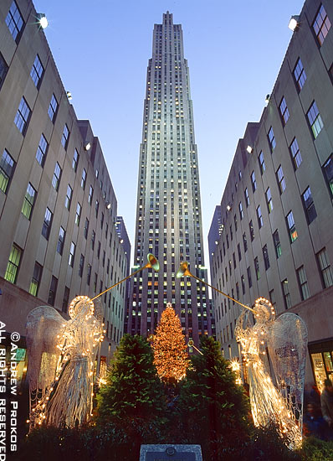
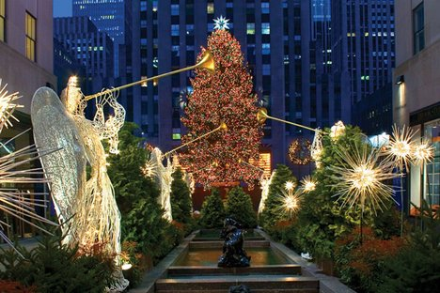
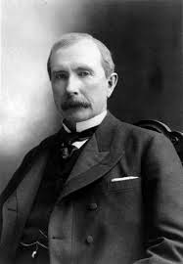
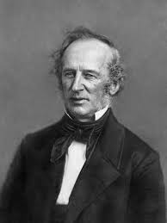
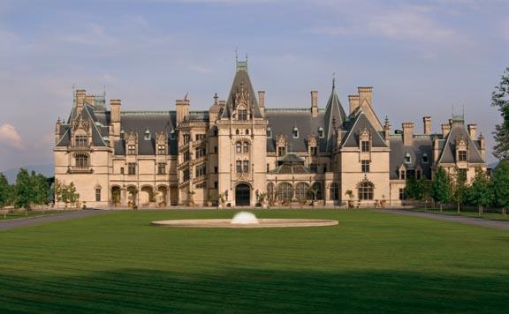
Billionaire Families from the Industrial Revolution Period
Rockefeller
Steel
Vanderbilt
Railroads

Slide 6
United States Expanding
The United States expanded beyond it’s boarders. Secretary of State William Seward arranged for the US to buy Alaska from Russia.
The United States took control of Hawaii in 1898.
We also have control of Puerto Rico, Guam, and the Philippines.

Slide 7
The World at War
1914 World War 1 broke out in Europe
Woodrow Wilson didn’t declare war until Germany began sinking American ships
Allied Powers – US, Great Britain, and France
Central Powers – Germany, Austria-Hungary, and Turkey
Allied won 4 years later in 1918.
The Peace Treaty at Versailles punished Germany and this lead to another war 20 years later

Slide 8
After the World at War
Economy boomed
Women could vote
More people bought cars, refrigerators, radios, and other modern marvels
Great Depression
Jobs lost
Factories closed
Farmers lost farms
Banks closed
Life savings were gone

Slide 9
World War 2
Adolf Hitler took control during the Great Depression in Germany
Hitler became dictator
Convinced the country they had to invade other countries to become powerful
1939 Germany invaded Poland and started World War 2
Hitler forced Jews, Gypsies, Slavs and others in brutal prison camps.
Millions were killed including 6 million Jews
Holocaust
1941 Pearl Harbor was attacked and the Americans joined the fight.
US declared war on Japan and Germany

Slide 10
Postwar Responsibilities
Soviet Union was formed
US scared Soviets were wanting to spread communism throughout the world.
This lead to the Cold War.

