Slide 1
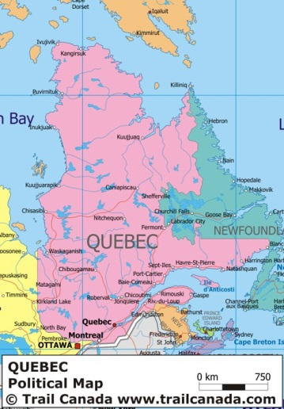
Quebec Preserving a Culture

Slide 2
Quebec
1977 all street signs had to be in French, now they are in both English and French
Government, commerce, and education in Quebec only uses French
83% of Quebec is French speaking; 12% is English; 5% speak other languages

Slide 3
The French influence in Quebec
Jacques Cartier (zhahk kahr Tyay) landed near today’s Quebec City
Montreal – French for “Mount Royal”
Cartier claimed this area for France and called in New France
As we know Great Britain also claimed it. CONFLICT!

Slide 4
Quebec – A District Society Within Canada
Majority French
Had to speak English at work and at school
Francophones did not like this!
New immigrants were taught English
Felt they were contributing lots of Canada but not getting much in return
Quebec is rich in natural resources
Which we learned is very important to Canada’s economy
Francophones only got low-paying jobs because they spoke French
Parti Quebecois (Pahr tee keh beh kwah)
French took control of the government
Tried to separate, majority voted no
Canadian government allowed Quebec to be a “distinct society”
Own way of life

Slide 5
Preserving Quebec’s Culture
“Quebeckers” celebrate their culture through festivals
Winter Festival that lasts 17 days
Canoe races among ice floes along the St. Lawrence River
Jean Baptiste
Festival to honor the patron saint, or special guardian of French Canadians
Held June 24
Bonfires
Firecrackers
Street dances
French style and cooking
Sugar pie – uses maple sugar from forests in Quebec
French style architecture – with Quebec variations

Slide 6
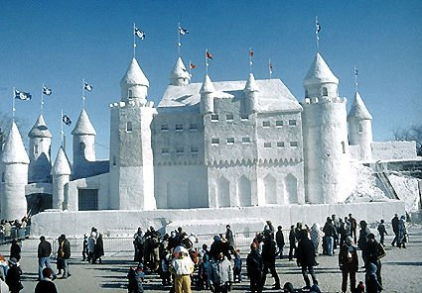
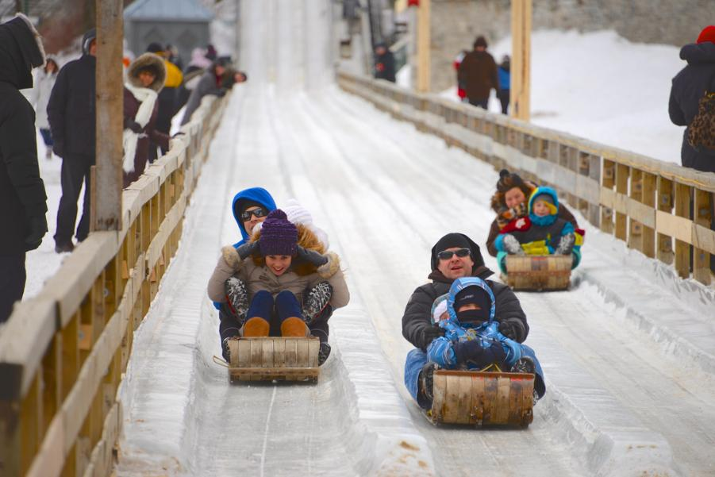
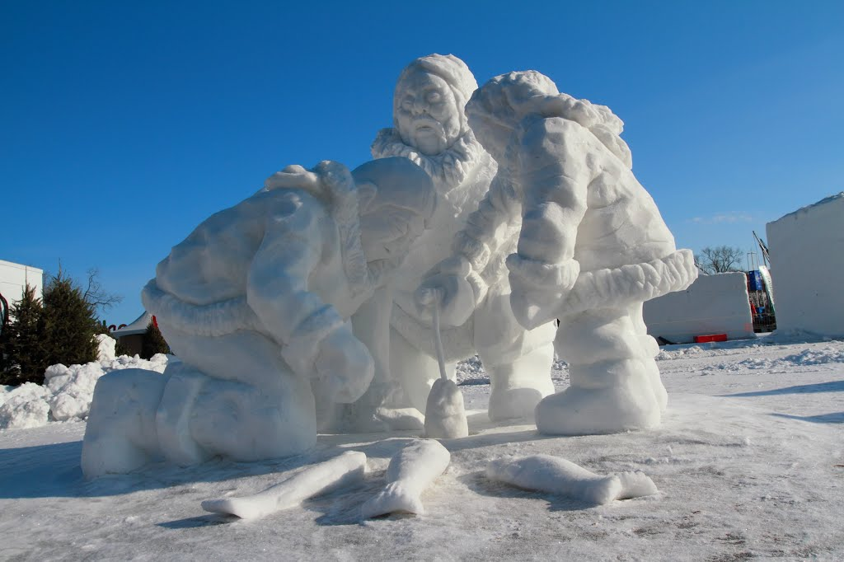
Winter Festival

